Slide 1


Atliq Hardware's
Consumer Goods ‘Ad-hoc- insights
Presented By
Prem Shiganalli

Slide 2
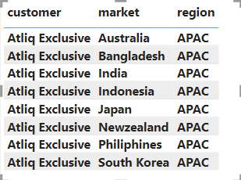
Request 1
Provide the list of markets in which customer “Atliq Exclusive” operates its business in the APAC region.

Slide 3
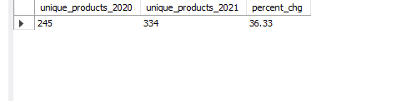
Request 2
What is the percentage of unique product increase in 2021 vs. 2020?

Slide 4
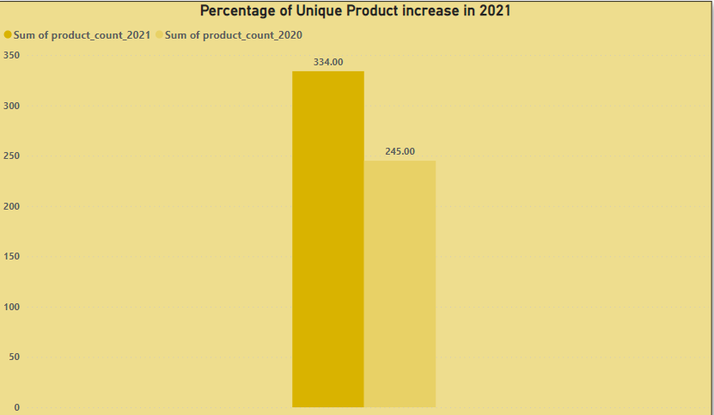
VISUAL DATA
89 unique products were added in 2021, Which results into 36.33% increase in the product count from 245 in 2020 to 334 in 2021

Slide 5
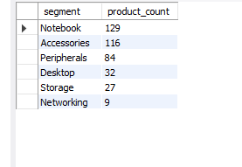
Request 3
Provide a report with all the unique product counts for each segment and sort them in descending order of product counts.
Output

Slide 6
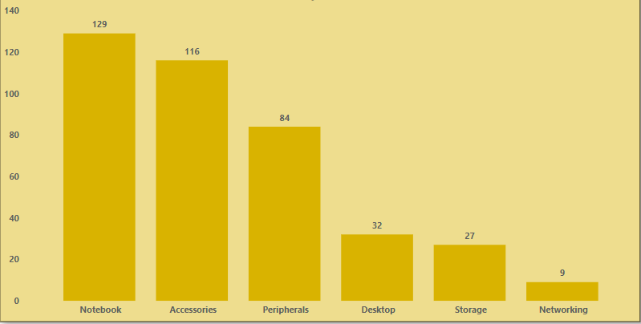
VISUAL DATA
The products are divided into 6 segments
Notebook segment has 129 product followed by Accessories, This 2 are in top
Network has only 9 product count

Slide 7
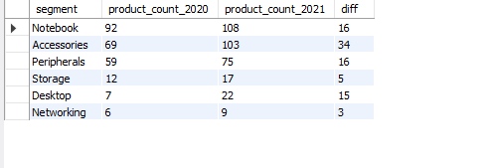
Request 4
Follow-up: Which segment had the most increase in unique products in 2021 vs 2020? The final output contains these fields,
Out Put

Slide 8
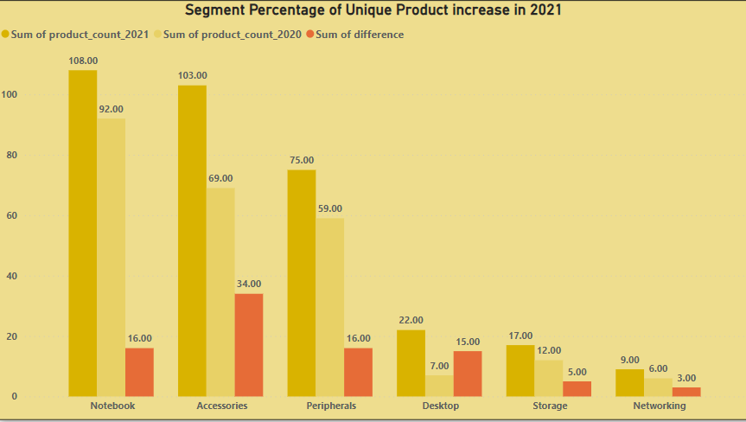
VISUAL DATA
Accessories segment has the most increase unique products in 2021
Networking segment has the least increase in unique products in 2021

Slide 9

Request 5
Get the products that have the highest and lowest manufacturing costs.
Output

Slide 10
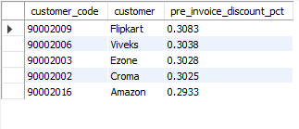
Request 6
Generate a report which contains the top 5 customers who received an average high pre_invoice_discount_pct for the fiscal year 2021 and in the Indian market.
Out put

Slide 11
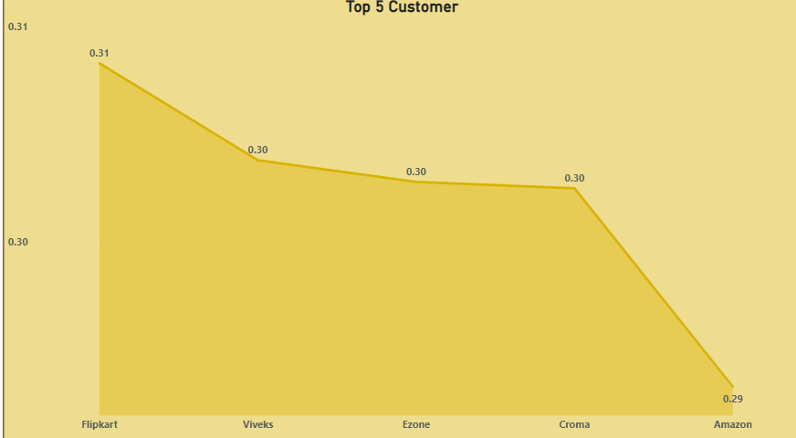
VISUAL DATA
Flipkart receive highest pre invoice discount in year 2021 from Indian market

Slide 12
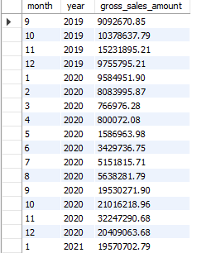
Request 7
Get the complete report of the Gross sales amount for the customer “Atliq Exclusive” for each month. This analysis helps to get an idea of low and high-performing months and take strategic decisions.
Output

Slide 13
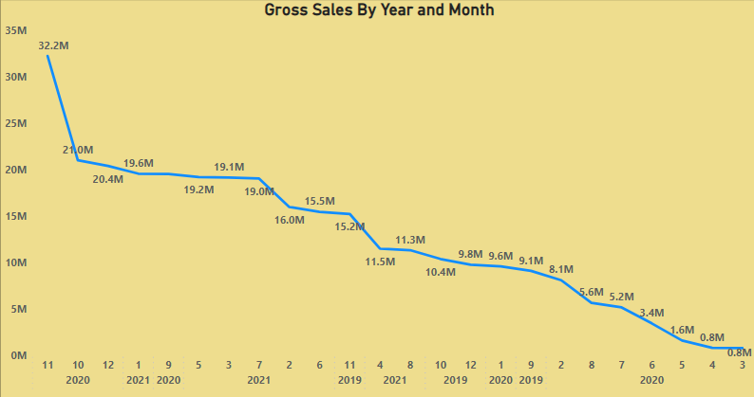
VISUAL DATA
Overall years for 2019, 2020 and 2021, April was the least performing month and November was the highest performing month.

Slide 14

Request 8
In which quarter of 2020, got the maximum total_sold_quantity?
Output

Slide 15
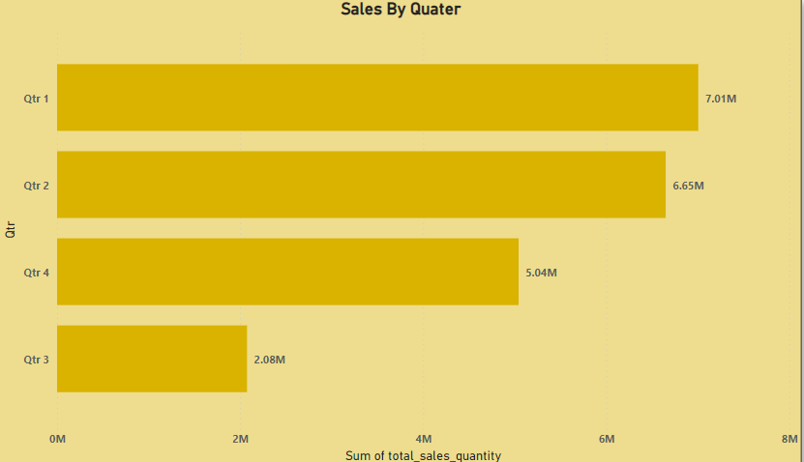
VISUAL DATA
Quarter 1 ('September', 'October', 'November') got the maximum total sold quantity.
Quarter 3 ('March', 'April', 'May') got the minimum total sold quantity.

Slide 16

Request 9
Which channel helped to bring more gross sales in the fiscal year 2021 and the percentage of contribution?
Output

Slide 17
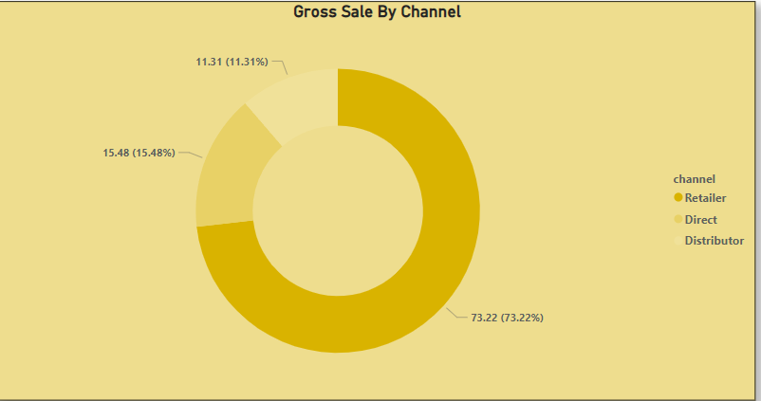
VISUAL DATA
Retailer channel helped to bring most gross sales i.e., 73.22%, in the fiscal year 2021.

Slide 18
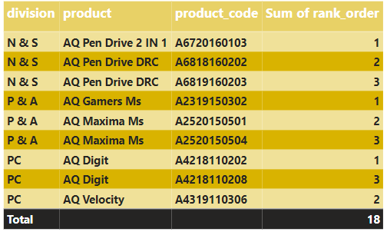
Request 10
Get the Top 3 products in each division that have a high total_sold_quantity in the fiscal_year 2021?

Slide 19
Thank You
Prem Shiganalli

